Slide 1
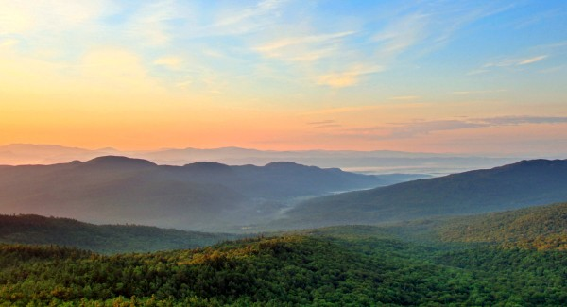
Land & Resource Management

Slide 2
Why do we have protected lands?

Slide 3
Reasons for Protected Land
Recreation (hike, camp, water sports, enjoyment)
Resource Management (hunting, fishing, lumber, fresh water)
Protection of Endangered Species
Protection of Unique Landscapes
Protection of Heritage Sites (historical sites)

Slide 4
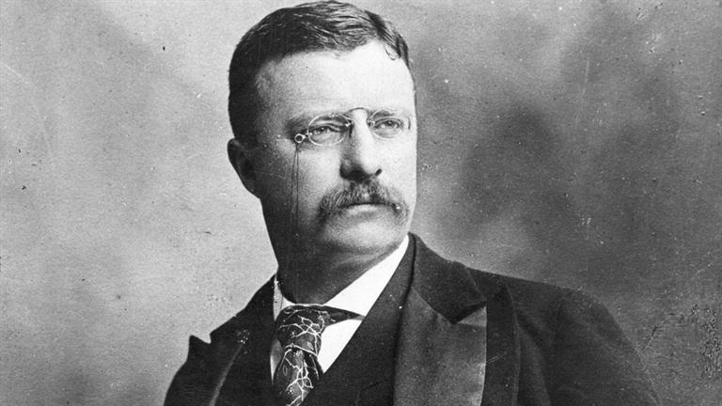
U.S History of Land Management

Slide 5
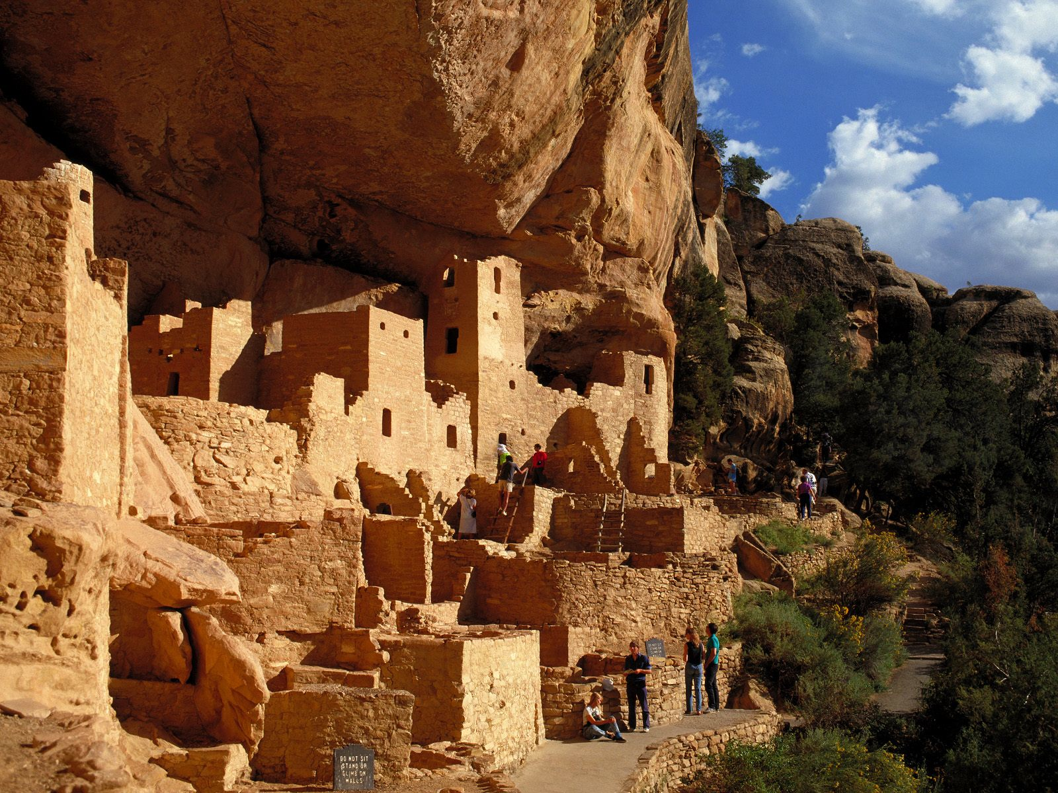
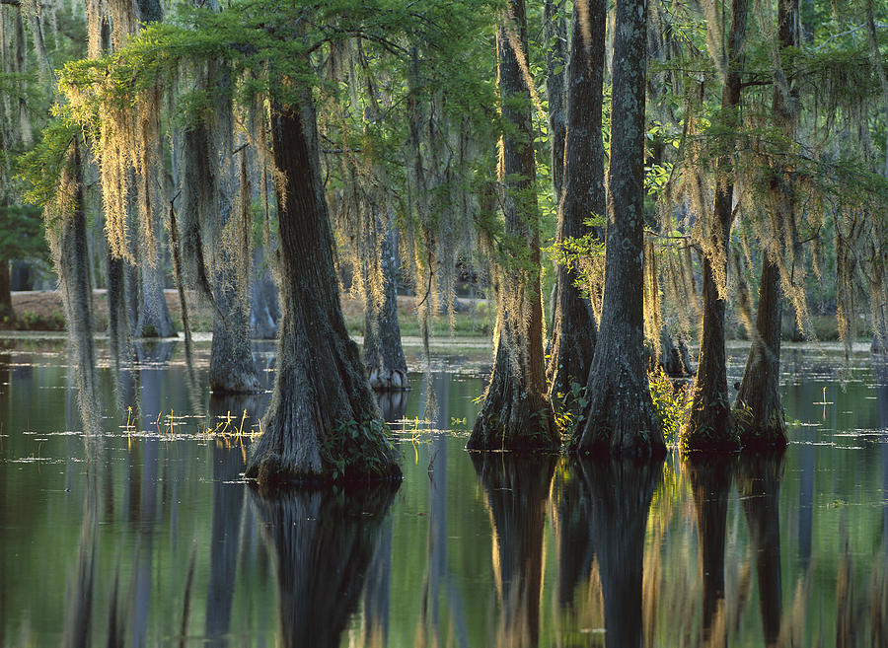
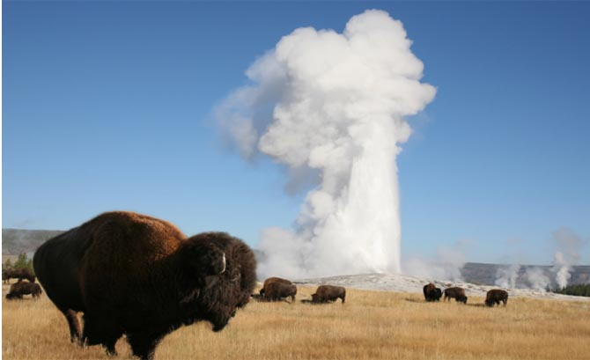
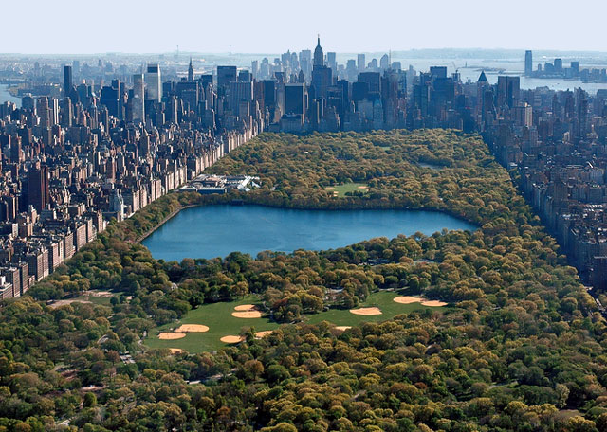

Slide 6
Preservation vs Conservation

Slide 7
Conservation: Environment and its resources should be used by humans and managed in a responsible manner
Preservation: Lands and their natural resources should not be consumed by humans and should instead maintain their pristine form

Slide 8
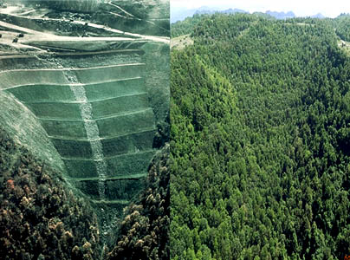
Succession

Slide 9
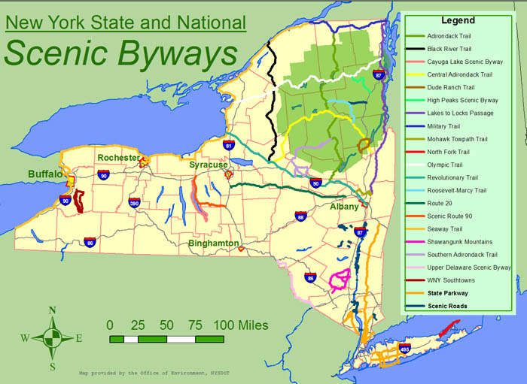
Hudson Crossing Park

Slide 10
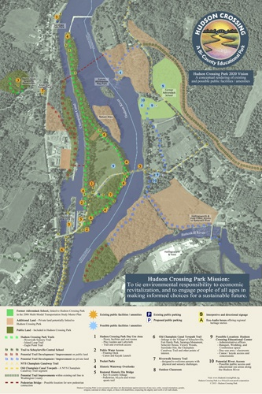
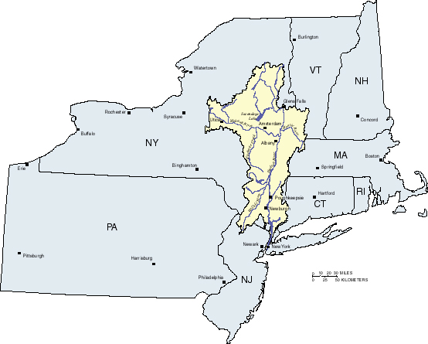

Slide 11
